Slide 1
CS1010X Tutorial 9:Object-Oriented Programming
10th May

Slide 2
Background
What is Object Oriented Programming (OOP)?
What benefits does it give us?
OOP is based around breaking our code into objects that have certain properties.
We will consider certain features of OOP today and throughout CS1010X:
Inheritance
Polymorphism
Encapsulation
In addition, we have inbuilt python class functions.
After addressing the tutorial questions we’ll give a bit more detail about these concepts.

Slide 3
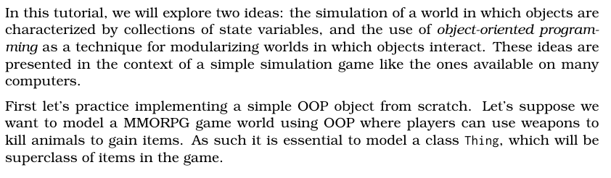
Background – We’ll be implementing this and using hungry_games

Slide 4
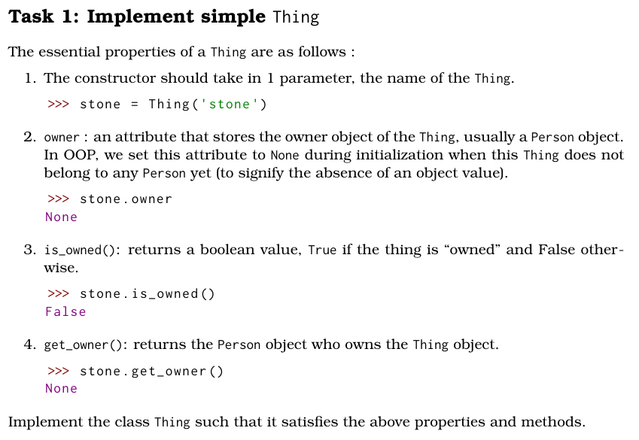
Task 1

Slide 5
Task 1:
What is the key information? –
What is a class? And what is an object?
Thing Class:
-> Overall properties: 1 parameter + 1 additional attribute
-> 2 methods to define
What do all these key words even mean?

Slide 6
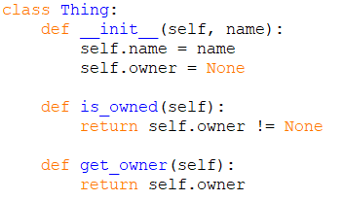
Task 1:
Key inbuilt python special class functions such as __init__ provide significant functionality.
Do you know any others?

Slide 7
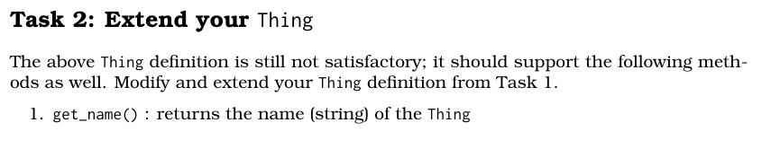
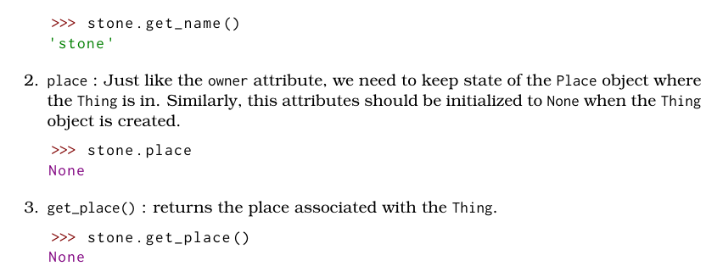
Task 2

Slide 8
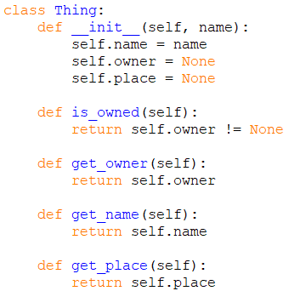
Task 2
Extending some of the functionality – this should be building on Task 1!

Slide 9
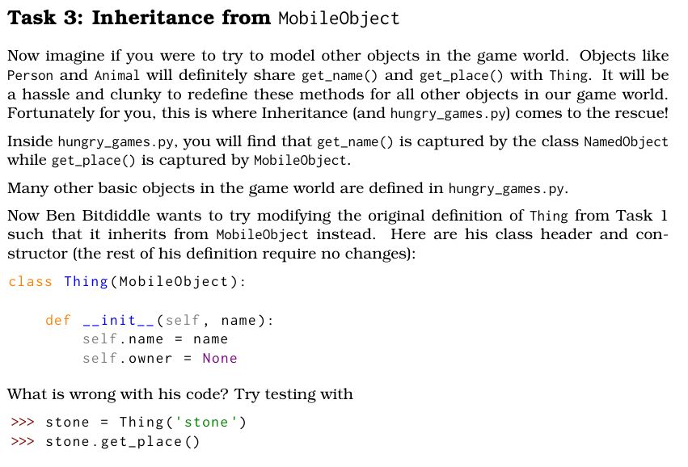
Task 3

Slide 10
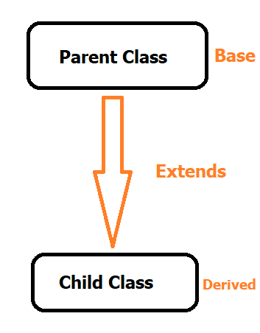
Task 3
What is Inheritance ???
Inheritance is the idea of getting existing methods and attributes from a Parent Class
What is a Parent vs Child class?
What does it mean to extend?
Extending from a Class means building on its functionality. We can gain its methods and attributes whilst extending with specific features.
For example:
An electric car is a motor vehicle has wheels and doors like any other car but has a battery not found in other cars.

Slide 11
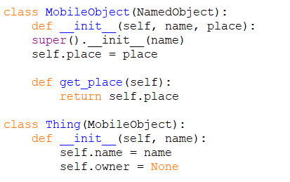
Task 3
Now that we understand it a bit better… what’s wrong with Ben’s code?
Ben’s code doesn’t actually access the properties and methods from the Parent class.
Instead, we can consider using super()

Slide 12
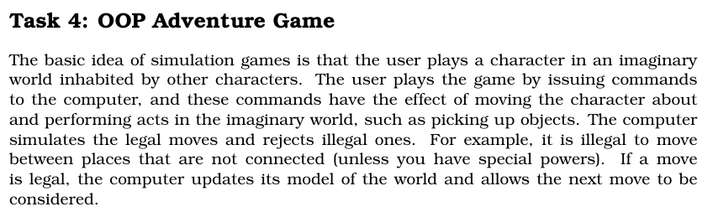
Task 4

Slide 13
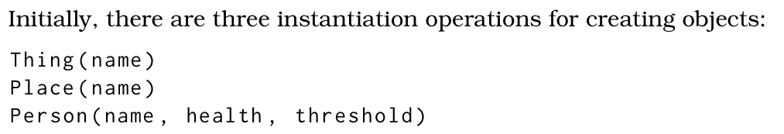
Task 4
Let's tackle Task 4 one step at a time
Let’s start by understanding the background. Key Points:
We have Things, Places, Person’s
We can put objects into a location “place”
We can move around between places
We can pick up objects
There are “turns”, controlled by a clock
There are also other “entities” that act similar to person’s i.e a troll

Slide 14
Task 4
We’re going to start with an Inheritance Diagram
Show the objects/classes defined
Demonstrate the inheritance relations between them
Outline the methods and attributes for each

Slide 15
NamedObject
name
get_name
is a
MobileObject
place
get_place
is a
is a
is a
Place
objects neighbour_dict
add_object del_object get_object get_exits add_neighbor get_neighbors get_neighbor_at
Thing
owner
get_owner is_owned
LivingThing
health threshold
get_threshold get_health add_health reduce_health go_to_heaven move_to act
is a
Person
inventory
take go get_inventory objects_around get_exits

Slide 16
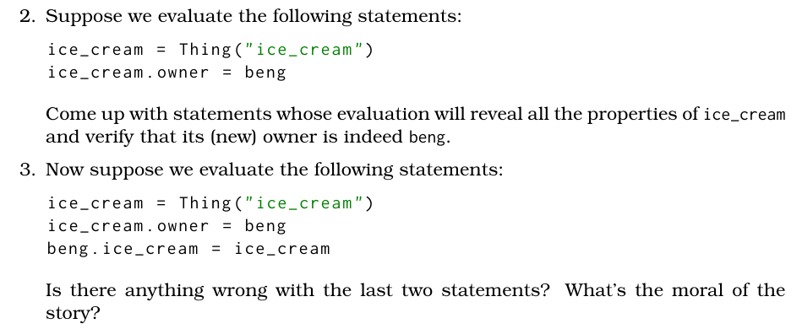
Task 4
Evaluating some statements

Slide 17
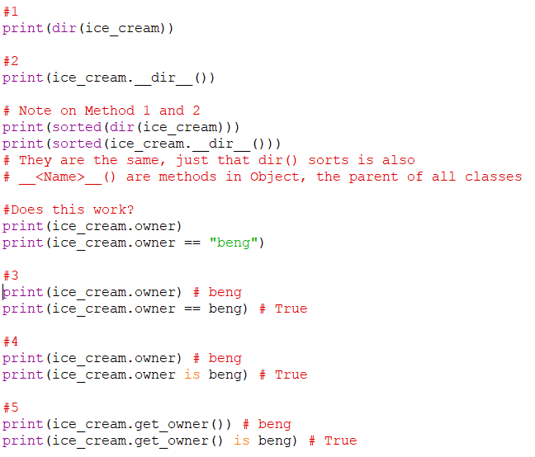
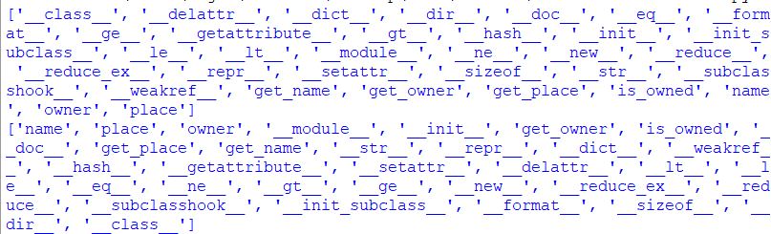
Task 4
Revealing the properties of ice_cream use dir or .__dir__()
Beng is an object! Not a string.
Hence, we need to use appropriate comparisons

Slide 18
Task 4
This is a trick question.
These statements are perfectly legal in Python.
Yes, we can easily create and add new attributes to any class, even if not intended.
However, this can be problematic when debugging, so it’s best practice to avoid doing so and making use of structure in our classes.

Slide 19
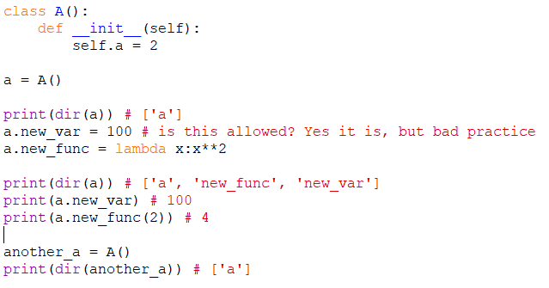
Task 4
Here’s an example!
By ignoring the common properties we can see that we have manually added these parameters and methods into our object ‘a’. However, no such properties exist for ‘another_a’

Slide 20
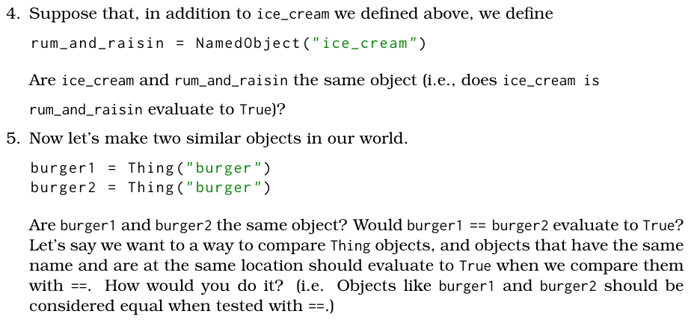
Task 4
When are objects considered the ‘same’ object?

Slide 21

Task 4
When are objects considered the ‘same’ object?
False, they are different objects with different IDs

Slide 22

Task 4
When are objects considered the ‘same’ object?

Slide 23
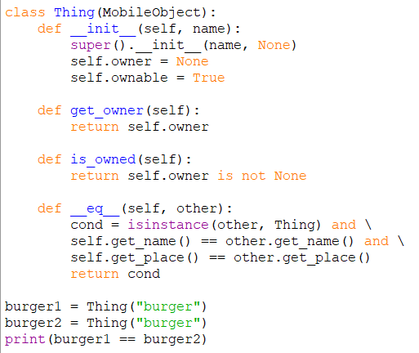
Task 4
The == sign is equivalent to the __eq__ python special function.
Within our class we can redefine what we want == to mean
This lets us change our conditions to compare two objects since we want them to evaluate as true if they have the same name and location.

Slide 24
Any Questions?

Slide 25
Additional – If Extra Time
Abstraction
Encapsulation
Polymorphism
Inheritance
Instance Field vs Class Field

Slide 26
Inbuilt Python Methods
Common Methods
__init__
__eq__ -> ‘==‘
__lt__ -> ‘<‘
__gt__ -> ‘>’
__str__ -> ‘str()’
Each of these has a default property based on the object class which is the class all classes inherit from.
However, like seen in this tutorial we can override this behaviour if we need to. For example comparing objects.

Slide 27
Abstraction
Identify what should be visible, what should be hidden.
To avoid breaking abstraction you should only use available functions and avoid “hard-coding” any solutions.
Do not assume implementation

Slide 28
Encapsulation
Hiding information and preventing people from directly accessing unnecessary data.
Languages such as java will have private variables and methods to prevent access
Does this exist in python?

Slide 29
Polymorphism
We can call the same methods on different objects
Overloading: Functions take different types of arguments, not really possible in python
Overriding: Functions in different classes handle the same arguments differently

Slide 30
Inheritance
Classes can have parent class. The child class will inherit the methods and attributes of the parent class.
The child class can override methods or attributes if needed

Slide 31
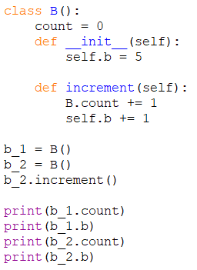
Instance field vs Class field
Class parameters are common across all objects of that class
Instance parameters are specific to that instance.
We can see this through self.b and B.count

Slide 32



Attribute Searching
What is attribute searching?
Attribute searching in python means deciding which variable to select – what if there are multiple parameters with the same name?
Python will check for an instance first before checking for class parameters.
If multiple instance or multiple class parameters exist. The one in the child class will be used first.

Slide 33
Systematically tracing
Breaking down attribute finding in Python
Search the __init__() section of the instance’s class.
If haven’t encounter super().__init__() but found the field, set it to be this
If encounter super().__init__(), visit the parent’s __init__() section
If can find, set/override the field name to be the one you find
If cannot find, do nothing
If encounter the field name later down the line, override any existing field/set the new field to be this
If cannot find further down the road, check the current class field
If have, set it to be the class field value
If it doesn’t have, check the parent’s class field
If parent’s class field has it, then set it to be this
If not, throw Exception

